Slide 1


NCG603: Advanced Topics in Geocomputation
Spatial Prediction
Martin Charlton

Slide 2
Lecture Structure
Introduction
Spatial sampling
Global interpolators
Local interpolators (focusing on Kriging)
Digital elevation models
Density surfaces
We will use an example (zinc concentrations in Maas valley) discussed by Burrough and McDonnell.

Slide 3
Introduction
In many instances we may wish to model a feature as a continuous field (i.e. a 'surface'), yet we only have data values for a finite number of points. It therefore becomes necessary to interpolate (i.e. estimate) the values for the intervening points.
Interpolation may also be required to change the dimensions and/or orientation of a raster; or to convert between a raster and a TIN.
In most instances we will want to estimate the missing values is the same units as the known values, but we can also express missing values as probabilities.

Slide 4
Types Of Interpolation
Two main types:
  Global interpolation – use all the available data;
  Local interpolation – only use data in vicinity of the point being estimated.
Can also be classified as:
  Exact – interpolated values are not allowed to depart from known values;
  Inexact – interpolated values are allowed to depart from known values.
Thirdly, may be:
  Deterministic – provide no indication of possible errors
  Stochastic – provide probabilistic estimates

Slide 5
Maas data
It records contamination of the environment by selected metals along the Dutch bank of the River Maas just north of Maastricht
  UTM zone 32 eastings coordinates m
  UTM zone 32 northings coordinates m
  local coordinates m
  local coordinates m
  elevation above local reference level in meters
  distance from main River Maas channel in meters
  Cadmium in ppm
  Copper in ppm
  Lead in ppm
  Zinc in ppm
  percentage organic matter loss on ignition
  flood frequency class, 1: annual, 2: 2-5 years, 3: every 5 years
  3 unnamed soil types

Slide 6
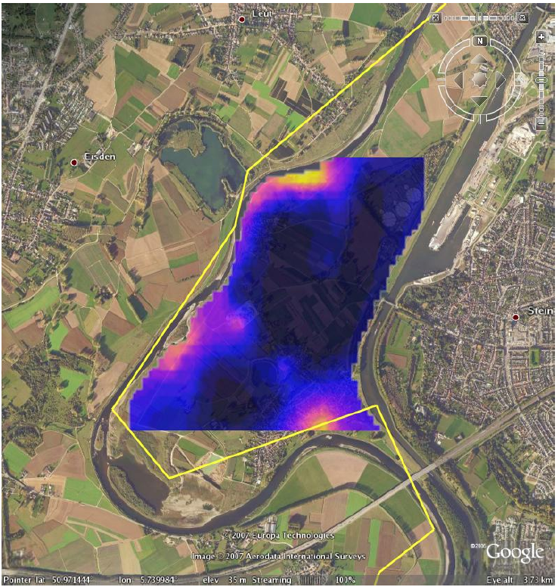

Slide 7
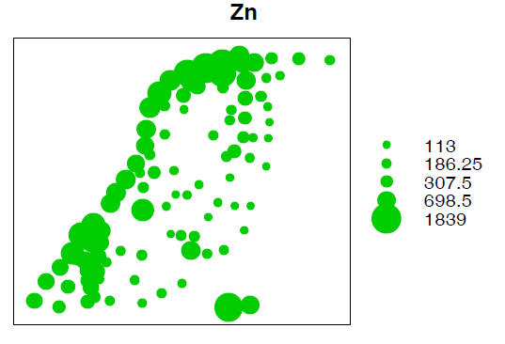
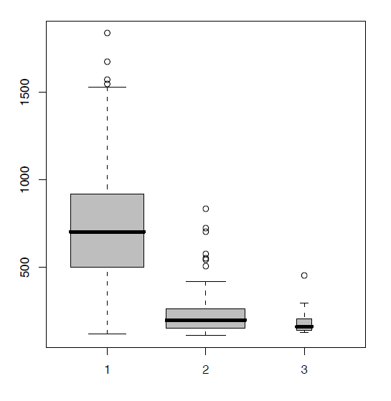


Slide 8
Spatial Sampling
Before we can interpolate we need some data values.
We ideally want as many sample points as possible, as widely spread as possible.
The area or volume sampled at each point is known as the support.
There are various ways in which sample points might be selected.

Slide 9
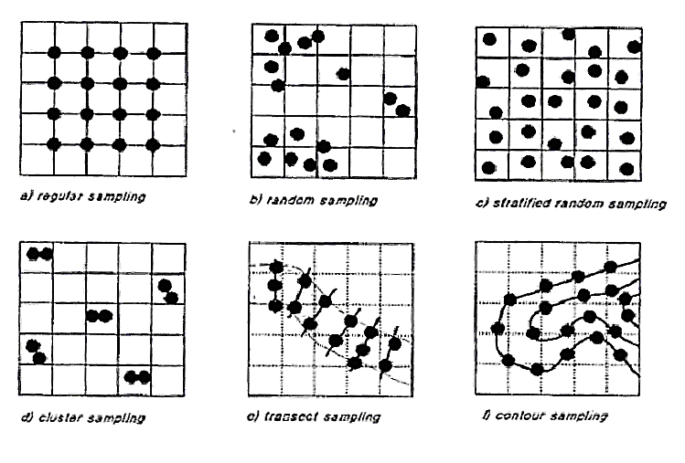

Slide 10
Global Interpolators
Global interpolators use all the available data.
There are two main approaches:
  Classification
  Regression

Slide 11

Classification Based Techniques
Global, inexact and probabilistic.
Can be used if data are sparse.
We can assume that zinc levels are a function of flooding. Can divide study area into three zones based on flooding frequency. Zinc concentrations are given by:
z(x₀) – interpolated (estimated) value at some location x₀.
z(x₁…x_{n}) – observed data at locations x_{1…n}.
The best estimate for each flooding class (μ+ α_{k}) can be estimated from the known values.
Can test the usefulness of the classification method using an analysis of variance test.

Slide 12
Classification Techniques (2)
The classification approach makes a number of assumptions:
  Variations in the value of z within a flooding class are random (i.e. there is no spatial autocorrelation).
  The variance of the noise α_{k} is the same for all flooding classes.
  The zinc concentrations are normally distributed.
  Spatial changes in zinc concentrations occur in steps at the boundaries of the flooding classes.

Slide 13

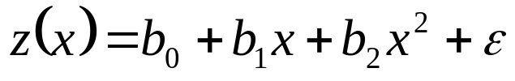
Trend Surface Analysis
Global, inexact and deterministic
A trend surface can be thought of as a high order three dimensional regression surface.
Consider a simple two dimensional transect:
This is the equation of a straight line (y = β₀ + β₁x + ε)
β₀, β₁, are the coefficients, ε is the random error term
Ordinary least squares estimator is β: = (X^{T}X)⁻¹X^{T}Y
X is the design matrix, β is a vector of coefficients
A second order polynomial (or quadratic) may provide a better fit:

Slide 14

Trend Surface Analysis (2)
A first order spatial trend surface (analogous to a simple regression line) is an inclined plane with the formula:
x and y are the coordinates of the observations
A second order trend surface would be an undulating surface with the formula:
Higher order trend surfaces include higher powers and more cross-product terms – e.g. a third order surface has 10 terms.
Higher order trend surfaces provide a better fit, but this may not be the objective.

Slide 15

Regression Techniques
Global, inexact and stochastic
Like the classification approach, regression techniques make use of ‘external’ (i.e. predictor) variables.
Example model is:
IDistance from river (P₁) and elevation (P₂) can be easily calculated using a GIS. By calculating these values for sample points, we can estimate the parameters (b₀,b₁,b₂).
Knowing the parameters we can estimate the zinc concentrations for any point we wish.
Note that this is an aspatial model.
BUT there might be spatial structure in the residuals ε. They should be mapped and Moran’s I tested

Slide 16
Other Global Interpolators
Other variations on the theme include:
  Fourier analysis
  Spectral analysis
Require large amounts of data at different scales.

Slide 17
Local Interpolators
If you believe there may be second order effects, then it makes sense to estimate the unknown values using only nearby known values.
General procedure is:
  Define a search area around the point to be estimated;
  The sample points within the search area are identified;
  A mathematical function is selected to model the local variation between these points.
  The data value for the point is estimated from the function.

Slide 18
Thiessen Polygons
Local, exact, deterministic.
Thiessen polygons (Dirichlet or Voronoi diagrams) are constructed around the known data points.
All points within the same polygon are closer to that known data point than to any other and are assumed to have the same value.
To construct a Thiessen polygon:
  Join sample points by lines forming sides of a Delaunay triangle.
  Draw lines at right angles at the mid point of each side of the triangles. These lines define the polygons.
Thiessen polygons have a characteristic convex shape. Can be distorted towards the edge of the study area

Slide 19
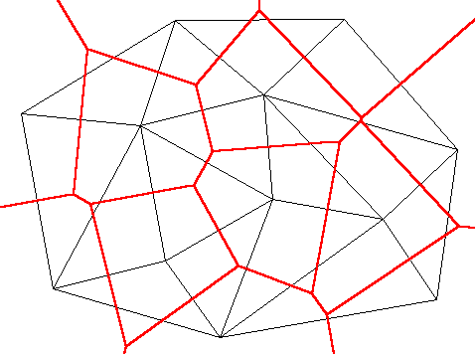
Thiessen polygons
The sample points are connected with a Delaunay triangulation (gray)
The bisectors of the sides of each triangle can be connected to form Thiessen polygons
Sample points are at the centre

Slide 20
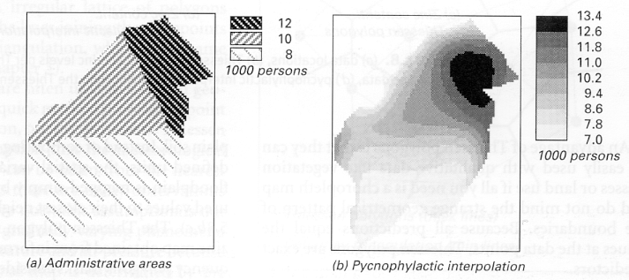
Pycnophylactic Interpolation
Thiessen polygons often produce sharp jumps in values at the polygon edges (could be intended for categorical data)
Could smooth using pycnophylactic interpolation.
Volume under the surface integrates to that for the polygon
Dasymetric mapping is somewhat similar but uses external information (admin areas intersected by land classes: people don’t live in lakes!)

Slide 21
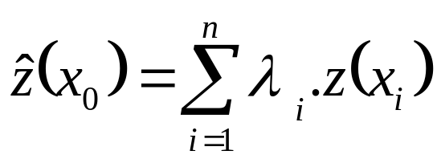
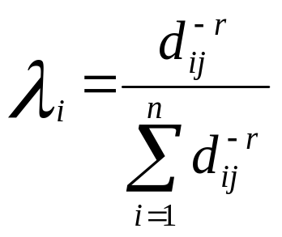
Weighted Moving Averages
Local, exact and deterministic
Family of techniques, best known of which is inverse distance weighting.
General formula is:
Weights must λ_{i} sum to 1.0
IDW weights are calculated using:
r be set to any value, but 2 is a popular choice.
Little theory to guide choice for r: could fit to observed data using crossvalidation.
weight
Divide by total to make weights sum to 1

Slide 22
Weighted Moving Averages (2)
If the point to be interpolated corresponds with an observed data point, d_{ij} would be zero and the weight would be infinite. The interpolated value is just set equal to the observed value in such situations.
IDW sometimes produces ‘duck egg’ patterns due to outliers.
Increasing search radius may result in over-smoothing.
Alternative is to use a fixed number of points for each estimation.

Slide 23
Splines
Local, exact and deterministic
Analogous to a traditional cartographer’s flexible ruler.
Piece-wise functions constrained to join at break points.
Usually fitted using second or third order polynomials.
May be 2-D or 3-D (e.g. bicubic spline).
Break points may correspond to known data points or some point in between.
Thin plate splines are an inexact alternative – produce a smoother (i.e. less jagged surface).

Slide 24
Kriging
Local, exact and stochastic.
Regarded by many as the best method:
  Given sufficient data, kriging produces better estimates than the other methods because the method takes explicit account of the effects of random noise.
  Although the investigator can choose between different types of kriging, kriging is less susceptible to arbitrary decisions taken by the investigator (e.g. search distance, number of sample points to use, location of break points, etc.). Kriging identifies the optimal interpolation weights and search radius.
  Kriging provides an indication of the reliability of the estimates.
Complex – almost a science in itself.

Slide 25
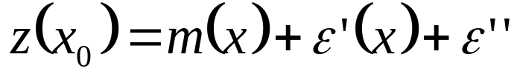
Kriging (2)
Kriging models the attribute as a stochastic surface or random field.
Regionalized variable theory assumes that the spatial variation of any variable can be expressed as the sum of three components:
  A structural component having a constant mean or trend;
  A random, but spatially correlated component, known as the regionalized variable; and
  Spatially uncorrelated random noise i.e. residual component.
  x₀ is the location of the point where an estimate is required
  x_{i} is the location of the ith data point
  Z is the value of some variable of interest

Slide 26

Kriging (3)
The first step is to decide on a suitable function for structural component m(x).
  Simplest is to assume a flat surface with no trend.
Under this assumption, the mean expected difference in value between two points is zero, i.e.
We also assume the variance of the differences is a function of the distance, h, between the points:
where γ(h) is known as the semivariance.

Slide 27
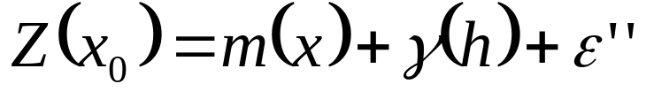
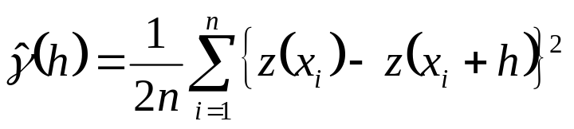
Kriging (4)
Under these two assumptions, the original formula can be written:
The semivariance can be estimated from the sample data using the formula:
where n is the number of pairs of sample points separated by distance h.
An experimental semivariogram shows semivariance plotted against distance.

Slide 29
Kriging (5)
Characteristic features of the semivariogram include:
  Graph levels off beyond a certain distance – the horizontal bit is known as the sill.
  Distance where this occurs is referred to as the range.
  At distance zero, semivariance is non-zero – referred to as the nugget variance. It is a measure of random noise ε''.

Slide 30
Kriging (6)
The semivariance must be modelled by a mathematical function taking the form γ(x) = ….
Several options, e.g.
  A spherical model (a) is used when the variogram has the 'classic' shape.
  An exponential model (b) is used when the approach to the sill is more gradual.
  A linear model (c) may be the most appropriate when there is no sill within the study area.
  A Gaussian model (d) may provide a good fit when the nugget is small and the variation is very smooth.
Not every mathematical function is possible – the ones that are used are called authorised variogram models

Slide 32
Kriging (7)
Other variogram shapes may indicate a different course of action is required.
More complex variograms may be required in special circumstances:
  Anisotropic models may be developed if it is believed that there may be directional effects.
  A complex variogram may be required if is believed that the total variation is the sum of the effects of two or more regionalized variables.
  Different variograms may be required for different cover classes (e.g. rock types, land covers, etc.). In such situations a separate variogram should be calculated for each cover class.

Slide 33
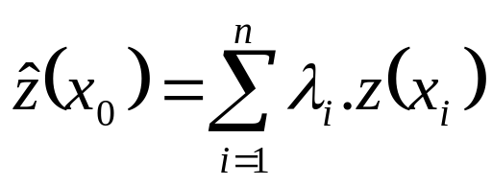
Kriging (8)
Once the variogram has been modelled, the next step is to determine the weights λ_{i} required for local interpolation.
The data value for each point can then be estimated using:

Slide 34
Kriging (9)
Can calculate the estimation variance (or kriging variance) as an indication of the reliability of the estimate at each location.
Can also test the variogram using cross validation.
The above describes ordinary kriging, but there are lots of variations on the theme.
Simple kriging: value of the structural component is known
Ordinary kriging: value of the structural component is the mean of the set of z_{i} values
Universal kriging: value of the structural component is estimated from the fitting of a polynomial trend model
  Variogram does not reach a sill but continues to rise
  1st order: m(x) = b₀ + b₁X(x) + b₂Y(x)
  2nd order: m(x) = b₀ + b₁X(x) + b₂Y(x) + b₃X²(x) + b₄Y²(x)
  Notice that these are similar to the trend surface models
Model based – you could have a house price model as the structural component

Slide 35
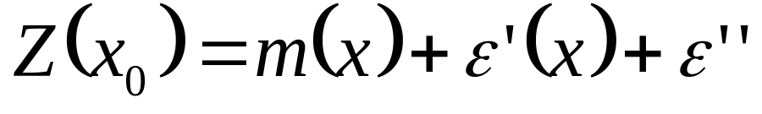
Kriging (10)
Recall the formula
... which we can re-arrange to give
  Z(x₀) - m(x) = ε’(x) + ε’’
The left hand side are the deviances from the structural component
The right hand side are the estimates from the variogram and the spatially random residual
So.... if m(x) is the estimate at x from a regression model, z(x) – m(x) is just the residual from the regression model

Slide 36
Kriging (11)
This seems complex…
The ArcGIS Geostatistical Analyst has an excellent interface to a rich set of Kriging functions
It is preferable to Spatial Analyst

Slide 37
ArcGIS Options
ArcGIS provides several interpolation options:
The Spatial Analyst extension provides:
  IDW
  Spline
  Kriging
The Geostatistical Analyst extension provides the above plus:
  Trend surface
  Local polynomial
  Radial basis function
  Addition kriging and cokriging options

Slide 38
Idrisi Options
Idrisi provides most of the options provided by ArcGIS plus a few others.
Idrisi provides an interface to open-source software called GSTAT developed in Utrecht. It also available at http://www.gstat.org/.

Slide 39
Acknowledgement
This lecture is abstracted from the excellent teaching resources developed by Professor Dennis Pringle, and available at:
http://www.nuim.ie/staff/dpringle/gis/index.htm
There’s some useful material at:
http://www.bias-project.org.uk/ASDARcourse/
(course on spatial analysis using R run by Roger Bivand)

